Slide 1
CS 4310: Software Engineering
Lecture 12
Software Engineering I
Midterm Exam Preparation

Slide 2
Midterm Exam
Midterm covers weeks 1-5 of the course notes
Project topics and concepts
Requirements Analysis
Systems Analysis
Object Oriented Analysis
The Analysis Document

Slide 3
Week One
Software Development Life Cycles
Phases of Systems Development & the Software Process
Strategies for Systems Analysis and Problem Solving

Slide 4
The Software Process
Feasibility and
Planning
Requirements
Design
Operation and
Maintenance
Implementation

Slide 5
Software Development Life Cycles (SDLC)
A system development life cycle (SDLC) is a logical process by which systems analysts, software engineers, programmers, and end-users build information systems and computer applications to solve business problems and needs.
It is sometimes called an application development life cycle. The SDLC usually incorporates the following general-purpose problem solving steps:
    Planning
    Analysis
    Design
    Implementation
    Support

Slide 6
Example SDLC
Waterfall Model
    The Waterfall model encourages software development to proceed in successive stages including operational specifications, coding specifications, coding, parameter testing, assembly testing, shakedown and system evaluation.
  FAST Model
    Uses a combination of techniques

Slide 7
Life Cycle Phases
Requirements
Definition
System and
Software design
Programming
and Unit Testing
Integration and
System Testing
Operation and
Maintenance

Slide 8
What is a Methodology?
A methodology is the physical implementation of the logical life cycle that incorporates:
    (1) step-by-step activities for each phase
    (2) individual and group roles to be played in each activity
    (3) deliverables and quality standards for each activity
    (4) tools and techniques to be used for each activity.

Slide 9
Systems Analyst
Systems analysis is the study of a business problem domain for the purpose of recommending improvements and specifying the business requirements for the solution.
Systems design is the specification or construction of a technical, computer-based solution for the business requirements identified in a systems analysis.

Slide 10
Modern Structured Analysis
Is a process-centered technique that is used to model business requirements for a system.
The models are structured pictures that illustrate the processes, inputs, outputs, and files required to respond to business events.
Structured analysis introduced an overall strategy that has been adopted by many of the other techniques – model-driven development.

Slide 11
Prototyping
Prototyping is an engineering technique used to develop partial, but functional versions of a system or applications. When extended to system design and construction, a prototype can evolve into the final, implemented system. Two ‘flavors’ of prototyping are applicable to systems analysis:
Feasibility prototyping is used to test the feasibility of a specific technology that might be applied to the business problem.
Discovery prototyping (sometimes called requirements prototyping) is used to ‘discover’ the users’ business requirements by having them react to a ‘quick-and-dirty’ implementation of those requirements.

Slide 12
Joint Application Development (JAD)
Joint application development (JAD) uses highly organized and intensive workshops to bring together system owners, users, analysts, designers, and builders to jointly define and design systems.
A JAD-trained systems analyst usually plays the role of facilitator for a workshop. This workshop may replace months of traditional interviews and follow-up meetings.

Slide 13
Object-Oriented Analysis (OOA)
Data and the processes that act upon that data are combined or encapsulated into things called objects. The only way to create, delete, change, or use the data in an object (called properties) is through one of its encapsulated processes (called methods). Object-oriented analysis (OOA) techniques are used to:
(1) Study existing objects to see if they can be reused or adapted for new uses, and to
(2) Define new or modified objects that will be combined with existing objects into a useful business computing application.

Slide 14
Week Two
The Engineering Process
Standards and Documentation
Requirements Specifications

Slide 15
What is Software?
Executable code in itself is not a saleable or deliverable product. Without data structures and documentation to support it, rarely would it function and it would most certainly be difficult to maintain.
Software = code + data structures + documentation

Slide 16
How SDLCs Work
The requirements phase contains all those activities in which you determine what the system or software is supposed to do.
Design analysts then take over and use those requirements to formulate the system or software design.
Programmers take the initial designs, in conjunction with the requirements and begin to "make it happen".
The test phase is concerned with testing the reliability of what has been created.

Slide 17
Standards and Documentation
Most of the SDLC models utilize some set of standards and documentation.
For a long time the military and industry used Mil-Std 498. This body of standards and documentation was canceled a couple of years ago. The Mil-Std 498 was document intensive and followed the traditional Waterfall model of software development.
It has been replaced by a series of new standards such as the International Standards Organization (ISO) 9000 and the Capability Maturity Model (CMM).

Slide 18
International Standards Organization (ISO) 9000
The ISO 9000 is a series of five standards that apply to a range of industries that includes software engineering.
The standards focus on documenting the process and measuring the results of implementing those processes.

Slide 19
Capability Maturity Model (CMM).
CMM is concerned with the level of maturity exhibited in a software development organization.
The model is broken down into five levels; each level contains a set of key practices and attributes that are characteristic of software organizations at that level of maturity.
CMM is process oriented.

Slide 20
Why Use Standards?
Standards are necessary to ensure that everyone uses the same naming conventions and programming constructs.
Consistency in programming reduces maintenance costs.
Documentation in programming usually consists of a software requirements document or specification (SRD or SRS), a software design document (SDD), and a wide range of other documentation.

Slide 21
Requirements Document
You should be familiar with what this document is used for but you DO NOT have to know what data or sections it contains or anything about the format information.

Slide 22
Software Requirements Specifications
Requirements state what the system should do
Design describes how it does this.
The requirements document is the official statement of what is required of the system developers. It should include both a definition and a specification of the requirements.

Slide 23
Two main Types of Requirements
Requirements set out what the system should do and define constraints on its operation and implementation
Functional requirements set out services the system should provide. These are mandatory for system functionality.
Non-functional requirements constrain the system being developed and specifies non-functional characteristics.

Slide 24
Week Three
Data Modeling and Flow Diagrams
Entity Relationship Models
Mapping Analysis to Design

Slide 25
Data Modeling
A way to structure unstructured problems is to draw models.
A model is a representation of reality. Just as a picture is worth a thousand words, most system models are pictorial representations of reality.
Models can be built for existing systems as a way to better understand those systems, or for proposed systems as a way to document business requirements or technical designs.

Slide 26
Logical and Physical Models
  What are Logical Models?
  Logical models show what a system ‘is’ or ‘does’. They are implementation-independent; that is, they depict the system independent of any technical implementation. As such, logical models illustrate the essence of the system.
  What are Physical Models?
  Physical models show not only what a system ‘is’ or ‘does’, but also how the system is physically and technically implemented. They are implementation-dependent because they reflect technology choices, and the limitations of those technology choices.

Slide 27
Entities
All systems contain data. Data describes ‘things.’ A concept to abstractly represent all instances of a group of similar ‘things’ is called an entity.
An entity is something about which we want to store data.
An entity is a class of persons, places, objects, events, or concepts about which we need to capture and store data. An entity instance is a single occurrence of an entity.

Slide 28
Attributes
The pieces of data that we want to store about each instance of a given entity are called attributes.
An attribute is a descriptive property or characteristic of an entity.
An attribute’s data type determines its domain. The domain of an attribute defines what values an attribute can legitimately take on.

Slide 29
Relationships
A relationship is a natural business association that exists between one or more entities.
A connecting line between two entities on an ERD represents a relationship.
A verb phrase describes the relationship.
All relationships are bi-directional, meaning that they can be interpreted in both directions.

Slide 30
Relationships…
Each relationship on an ERD also depicts the complexity or degree of each relationship and this is called cardinality.
Cardinality defines the minimum and maximum number of occurrences of one entity for a single occurrence of the related entity.
Because all relationships are bi-directional, cardinality must be defined in both directions for every relationship.

Slide 31
Data Flow Diagram (DFD)
A Data Flow Diagram (DFD) is a single process bubble with all inputs to and outputs from, the system represented.
Commonly called a ‘Context Diagram’, it includes providers of data to the desired system and users of the information formulated from that data as external entities.

Slide 32
Components of the DFD
External entities
Processing steps
Data stores or sources
Data flows

Slide 33
Example DFD
Rejection
Application
form
Completed
application
Receive
application
Evaluate
Offer

Slide 34
Process Specifications
A Process Specification is a textual description of the data process or flow.
Every process on a DFD should have a corresponding process description.
Process Specifications can be documented in a variety of ways.

Slide 35
Process Specification
Consider a DFD that contains a process called ‘Process Student Registration.’
Assume that there is also a diagram that represents the details of this process - processes such as
    ‘Verify Registration On Time,’
    ‘Verify Prerequisites Met,’
    ‘Verify Slot Available,’
    ‘Place on Standby List’
    ‘Record Registration’

Slide 36
Process Specification…
The ‘Process Student Registration’ specification could contain a general description, such as the following:
PROCESS STUDENT REGISTRATION
This process receives registration requests from students, ensures that they are valid, and records them in the database.

Slide 37
Process Specification…
Here is a sample Process Description for ‘Verify Registration On Time’:
Verify Registration On Time
      Get the Class Start Date from the Class table.
      Subtract 14 from the Class Start Date to determine Latest Registration Date.
      Get the Date the Registration Request was received by the Registrar
      from the Registration Request.
      If this date is not on the request, return it as incomplete.
      If the Date the Registration Request was received is later than the Latest
      Registration Date, reject the Registration Request as late.

Slide 38
Structured English
Structured English (sometimes called Pseudocode) resembles a simple narrative, but ‘structures’ conditional logic in such a way as to make it clear.
The advantage of Structured English is that it is easily understood by a variety of users while providing the specificity that software developers require.

Slide 39
Structured English…
When a student tries to register for a class, the following process is followed:
For each Form 17
If Class Date is not two weeks or more away
Reject as too late
Else
Check to see if Student has prerequisites for Course
If Prerequisites not met
Reject as Prerequisites not met
Else
Check for Available Slots
If Slots not Available
Reject for No Room
Else
Register Student

Slide 40
Entity Relationship Diagrams (ERD)
Entity Relationship Diagrams (ERDs) show the system entities and their relationships with other entities. Data process is not represented.
Data Flow Diagrams (DFDs) represent all data that is input, stored, transformed, and produced within a software application. They represent data in a logical way that can be translated into any number of physical structures.

Slide 41
Entity-Relation Diagram
An entity
A relation between entities
An entity or relation attribute

Slide 42
Example ERD
Book
Author of
Editor of
Creator
Describes
Catalog record
Subject heading
Is about
Short title
Control numb

Slide 43

Building ERD’s in Analysis
Assume we are told that an employee works for one branch (part of a company) and that each branch can have many employees. The relationship between employee and branch would look like this:

Slide 44

Building ERD’s in Analysis…
An employee can be a fire marshal for several branches, and each branch can have only one fire marshal. You would model this relationship like this:

Slide 45
Data Definitions and Stores
Data dictionaries are lists of all of the names used in the system models. Descriptions of the entities, relationships and attributes are also included.
Every Data Flow and Data Store View must be defined in terms of its data elements. These definitions are stored in the Data Dictionary.

Slide 46
Data Dictionaries
A data dictionary is a list of names used by the system
• Brief definition (e.g., what is "date")
• What is it (e.g., number, relation)
• Where is it used (e.g., source, used by, etc.)
Read pages 39-43 for more detailed examples of data stores and definitions.

Slide 47
Mapping Analysis to Design
Terms listed on pages 44-46 of your class notes:
Architecture Modularity
Functional Independents Transform Analysis
Transaction Analysis Design Patterns
Requirements Traceability Boss Module
Control Couple Data Couple
Verification Validation
You should be familiar with the terms in red.

Slide 48
Architecture
Architecture associates the system capabilities identified in the requirements specification with the system components that will implement them. Exploring architecture helps to:
Analyze the effectiveness of the design in meeting its state requirements.
Consider architectural alternatives.
Reduce the risk associated with the construction of the software.

Slide 49
Modularity
Modularity is the organization of software into separately named and addressable components.
Modularity is the single attribute of software that allows a program to be intellectually manageable.

Slide 50
Functionally Independent Module
Modules with:
    single-minded functions
    simple interfaces
    easy to develop and maintain
    Reusability
… are considered functionally independent.
Ideally all modules within a design should be functionally independent, although this goal is unrealistic.

Slide 51
Design Patterns
A Design Pattern names, abstracts, and identifies the key aspects of a common design structure that make it useful for creating a reusable design.
A Pattern must identify the components, their roles, and their relationships. A Design Pattern leads to reusability of software by allowing previously developed structures to be used to solve similar, but new, problems.

Slide 52
Requirements Traceability
Requirements Traceability describes the ability to identify where each of the lowest level requirements are implemented within a design.
Essentially, primitive level processes can be mapped to the specific module where that process is implemented.
Requirements Traceability supports change management throughout the development process.

Slide 53
Verification
The term Verification refers to the concept of determining that we are building the product correctly.
It assumes that the requirement is stated and interpreted properly and focuses on the way we have implemented that requirement.

Slide 54
Validation
The term Validation means to determine whether we are building the correct product.
Validation ascertains that we correctly understand the requirement.

Slide 55
Analysis Document
You should be familiar with what this document is used for but you DO NOT have to know what data or sections it contains or anything about the format information.

Slide 56
Week Four
Traditional versus OO Development
Object Oriented Analysis
Unified Modeling Language (UML)

Slide 57
Shifting from ERD to OOD
ERD Term |  | UML Term
Entity |  | Class
Instance of an entity |  | Object
Relationship |  | Association
Attributes |  | Attributes

Slide 58
Objects
An object is like a module that contains both data and the instructions that operate on those data. Data are stored in instance variables; the instructions for their manipulation are defined inside methods.

Slide 59
Messages and Methods
A message is a request to an object to act in a specified way.
The message may contain information to clarify the request, but the sender does not need to know how the receiver will carry out the request; it only need to know that it is carried out.

Slide 60
Classes and Instances
A class is a description of an object.
It contains data and methods that determine the common characteristics of a set of objects.
It is really an abstract definition of an object.

Slide 61
Object Oriented Analysis
Object based programming involves four general design concepts and can be remembered by thinking of "A PIE.“
  Abstraction
  Polymorphism
  Inheritance
  Encapsulation
  See pages 52 - 53 for definitions of the above terms.

Slide 62
Abstract Data Types (ADT)
An abstract data type (ADT) is a data type defined only in terms of the operations that may be performed on objects of the type.
Programmers are allowed to examine and manipulate objects using only these operations and they are unaware of how the objects are implemented in the programming language.

Slide 63
Programmer-Defined Classes
A class is an actual representation of an ADT.
It provides implementation details for the data structure used and the operations the class provides.

Slide 64
The Three Steps of OOA
1. Use-case modeling
    Determine how the various results are computed by the product (without regard to sequencing)
    Largely action-oriented
2. Class modeling (“object modeling”)
    Determine the classes and their attributes
    Purely data-oriented
3. Dynamic modeling
    Determine the actions performed by or to each class
    Purely action-oriented

Slide 65
Unified Modeling Language
A variety of modeling languages have evolved over time in support of traditional systems. We previously looked at some of the most common of these.
In the OO world a single unified standard is winning out as the universal syntax for modeling. That syntax is defined by the Unified Modeling Language (UML).

Slide 66
Types of UML Diagrams
Use Case
Class Diagram
Interaction Diagram (including both the Sequence Diagram and the Collaboration Diagram)
State Diagram
Activity Diagram
Component Diagram
Deployment Diagram
Read description on pages 61 – 63 in your class notes

Slide 67
Use Case and Class Modeling
Extract classes and their attributes
Represent them using an entity-relationship diagram
Deduce the classes from use cases and their scenarios
Often there are many scenarios

Slide 68
Class Diagram
Applet
generalization
HelloWorld
paint()
dependency
Graphics

Slide 69
Use Case Scenarios
A Use Case represents an interaction between an external entity and the target system.
The processing represented by that Use Case is defined in a Use Case Scenario.
A Use Case Scenario focuses on a single Use Case and a specific event associated with on occurrence of that Use Case.
It lists the individual steps involved to accomplish the function represented. If the steps would be different under different conditions, a different Use Case Scenario would be developed for each potential set of conditions.

Slide 70
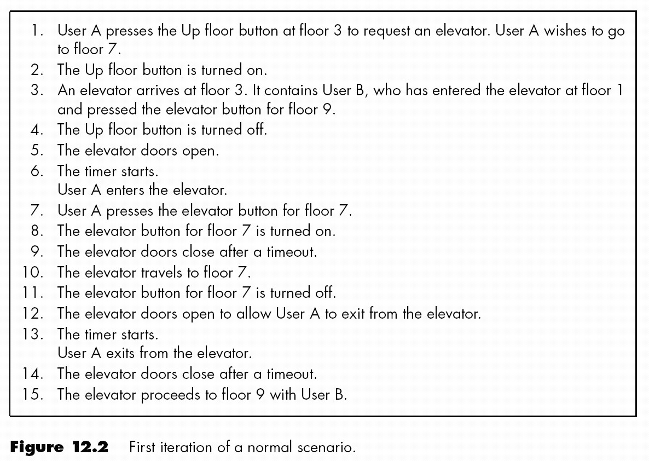
Use CASE Scenario

Slide 71
Actor and Use Case Diagram
• An actor is a user of a system in a
particular role.
An actor can be human or an external
system.
• A use case is a a task that an actor
needs to perform with the help of the
system.
BookBorrower
Borrow book

Slide 72
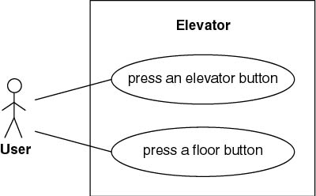
Scenario Example
Use case: Generic description of overall functionality
  Scenario: Instance of a use case

Slide 73
Use Cases for Borrowing Books
Borrow copy of book
Book Borrower
Return copy of book
Reserve book
Extend loan

Slide 74
Week Five
Object Oriented Design
Coupling and Cohesion

Slide 75
Transform Analysis
Transform analysis is an examination of the DFD to divide the processes into those that:
    perform input and editing,
    those that do processing or data transformation (e.g., calculations),
    and those that do output.
Know the meaning of Transform Analysis. You do NOT have to know the 7-step process on pages 66 and 67.

Slide 76
Types of Design Objects
Read descriptions on pages 67 – 68 in the class notes
Design Objects: All objects in the System Design
Entity Objects: The objects that represented actual data within the business domain.
Interface Objects: It is through interface objects that the users communicate with the system.
Control objects: Contain behavior that does not naturally reside in either the interface or entity objects.

Slide 77
Coupling and Cohesion
Coupling and Cohesion are the two primary measure of the quality of design for both OO and traditional systems.
Coupling is a measure of the interdependence between modules - how much data and control needs to be passed to enable your overall design to function. Coupling should be minimized.
Cohesion is a measure of the strength of association of the components within a module - did we package code that belongs together. Cohesion should be maximized.

Slide 78
Coupling and Cohesion…
Have an understanding of what Coupling and Cohesion are by reading pages 69 – 75 but you do NOT need to know the different types of Coupling and Cohesion or how to apply the concepts.

Slide 79
Software Design Specification
You will NOT be asked question about the Software Design Specification that appears that the end of the week five notes.

Slide 80
Midterm Exam Specifics
15% of your total grade for the class
You will have the entire class time (1 hour, 50 min)
You will need to create 1 simple ERD
You will need to create 1 simple DFD
Short answer and multiple choice type questions
NO fill-in-the-blank
No True/False
Good Luck!

